Slide 1
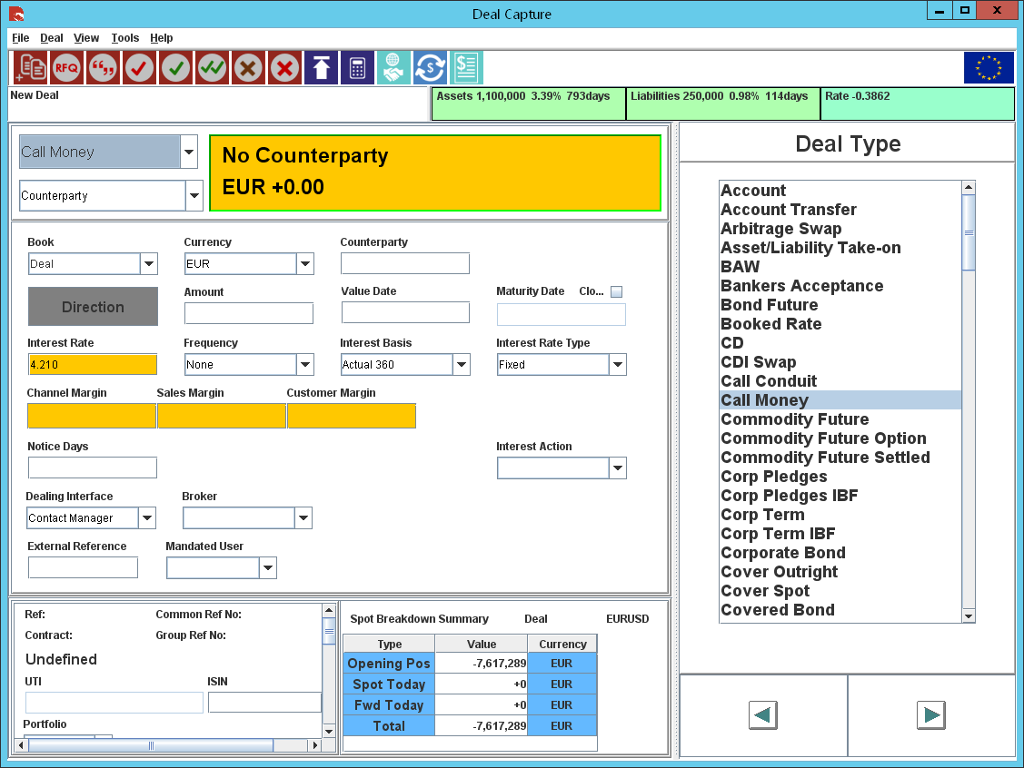
Instant Access %
Statement Frequency
Early Withdrawal
This field value should be defaulted to “UnTicked” and be disabled.
Allow 3rd Party Payments
CR/DB Advices

